Slide 1





WiFi Connection notes:
Private IP Address (10.0…)
LED on the WiFi dongle shows network connection
Can be configured to automatically connect to a network
Can connect via telnet (requires installation) or ssh
Canakit WiFi Dongle
Bluetooth Connection Notes:
169… IP Address
Max Bluetooth Connections:
5 to Mac
1 to PC

Slide 2
Install Telnet
Telnet is insecure, but the EV3s have private IP addresses
Install on EV3
Updates the package list
sudo apt-get update
Install Telnet package
sudo apt-get install telnetd
Install & Connect on Mac
Use Homebrew to install telnet
brew install telnet
Connect with Telnet
telnet -l robot <ip address>
Password: maker
Using Telnet in Python

Slide 3


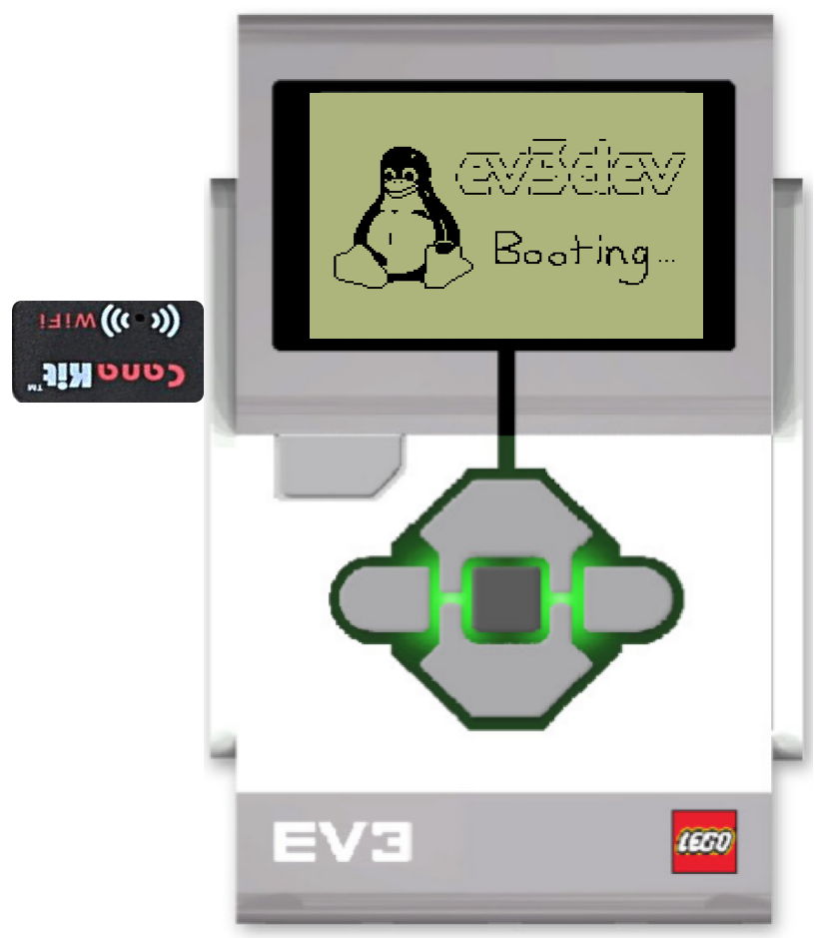
Control EV3 with python script
SSH or Telnet
EV3 Running EV3Dev with CanaKit WiFi Dongles or BT
MacBook
Hardware
Wireless Network
Programming
User Inputs

Slide 4
Wireless Network
Mac publishes local webserver
Mac sends python3 commands to EV3 via telnet from terminal
EV3s connect to the wireless network on startup
Mac sends commands to terminal from local webserver
Open webserver & enter commands
EV3s Running EV3Dev with CanaKit WiFi Dongles
MacBook
Hardware
Wireless Network
Programming
User Inputs

Slide 5
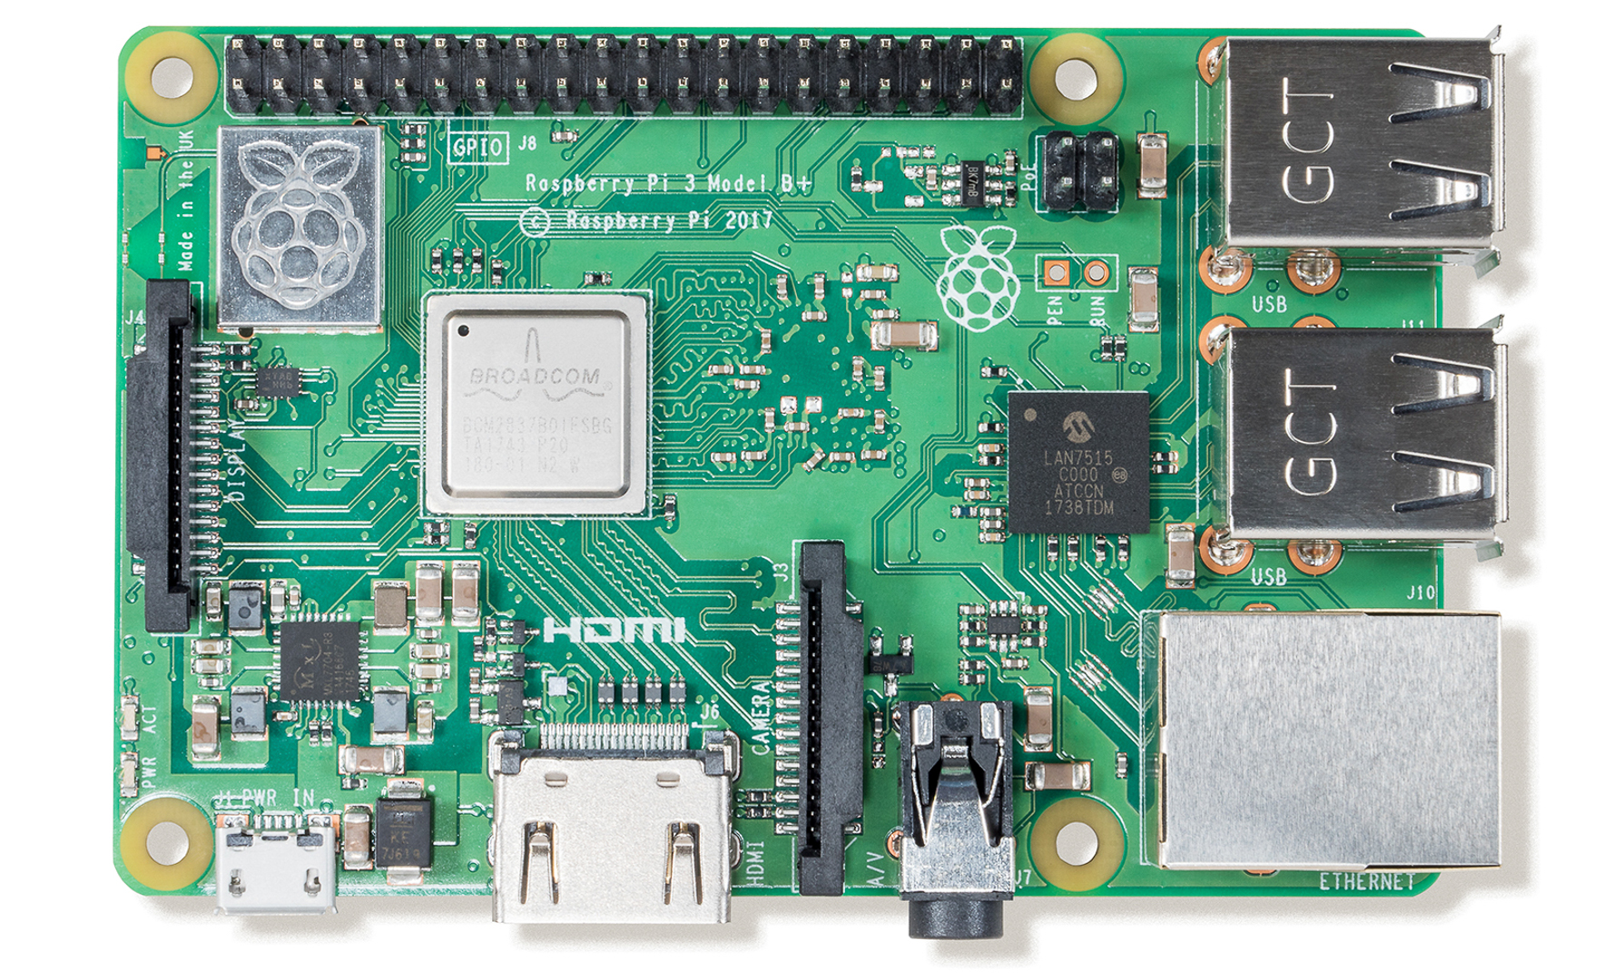

*Working on python script to read IP addresses
Wireless Network
RasPi reads IP addresses on the network and identifies EV3s*
Computer sends commands via router level webserver
RasPi publishes router level webserver
EV3s connect to the wireless network on startup
RasPi sends python3 commands to EV3 via telnet based on inputs to webserver
Open webserver, select EV3*, & enter commands
EV3s Running EV3Dev with CanaKit WiFi Dongles
Raspberry Pi
Computer
Hardware
Wireless Network
Programming
User Inputs

Slide 6
*Working on python script to read IP addresses
Wireless Network
RasPi reads IP addresses on the network and identifies EV3s*
Computer sends commands via router level webserver
RasPi publishes router level webserver
EV3s connect to the wireless network on startup
RasPi sends python3 commands to EV3 via telnet based on inputs to webserver
Open webserver, select EV3*, & enter commands
EV3s Running EV3Dev with CanaKit WiFi Dongles
Telnet
Raspberry Pi
SSH
Computer
Hardware
Wireless Network
Programming
User Inputs

Slide 7
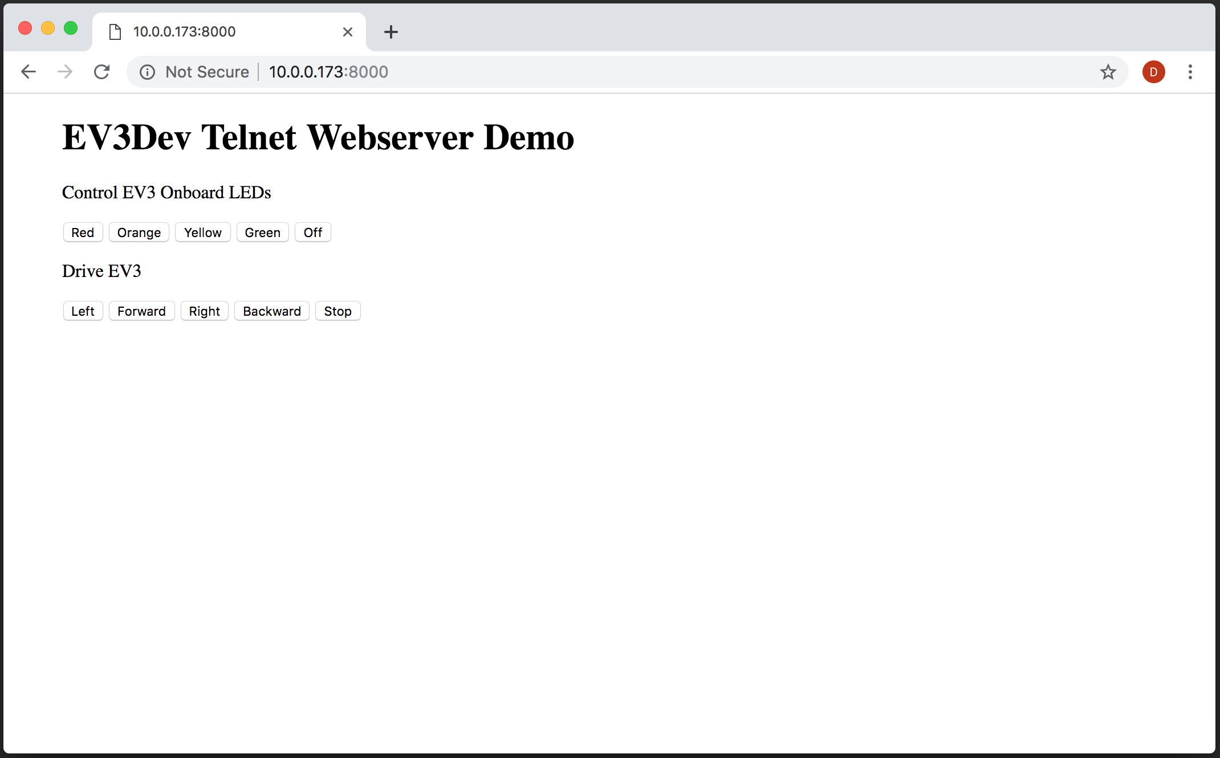
Webserver Demo
EV3 Setup
Configure EV3s to automatically connect to the wireless network
Raspi Setup
Connect to wireless network
Run WebserverDemoRasPi.py using python3 (can run on startup)
MacBook Setup
Once the connection between the EV3 & RasPi is initiated and the webserver is created, navigate to <raspi IP>:8000
Website Enhancements:
Add a slider bar for controlling speed
Add drop down menu for selecting EV3 (currently controlled in terminal)
Add landing page for when EV3 isn’t connected

Slide 8
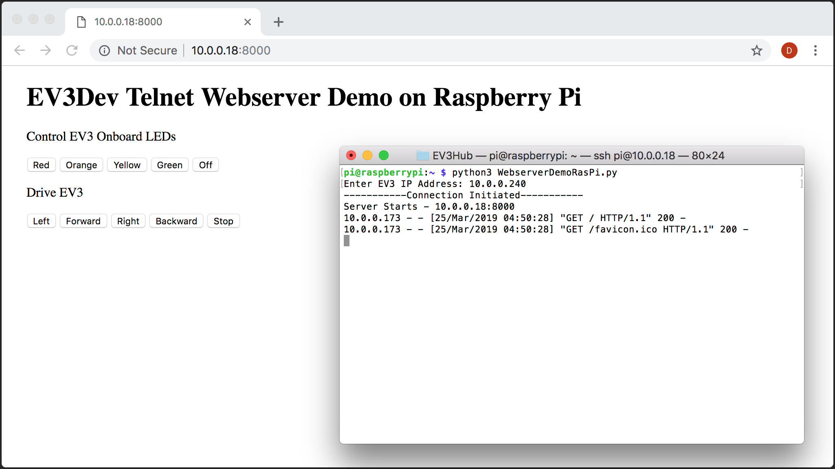

Slide 9
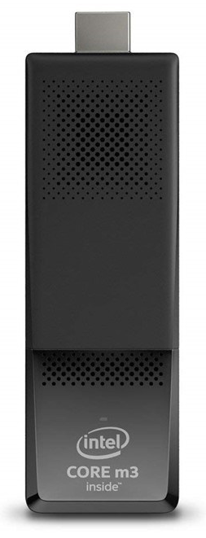
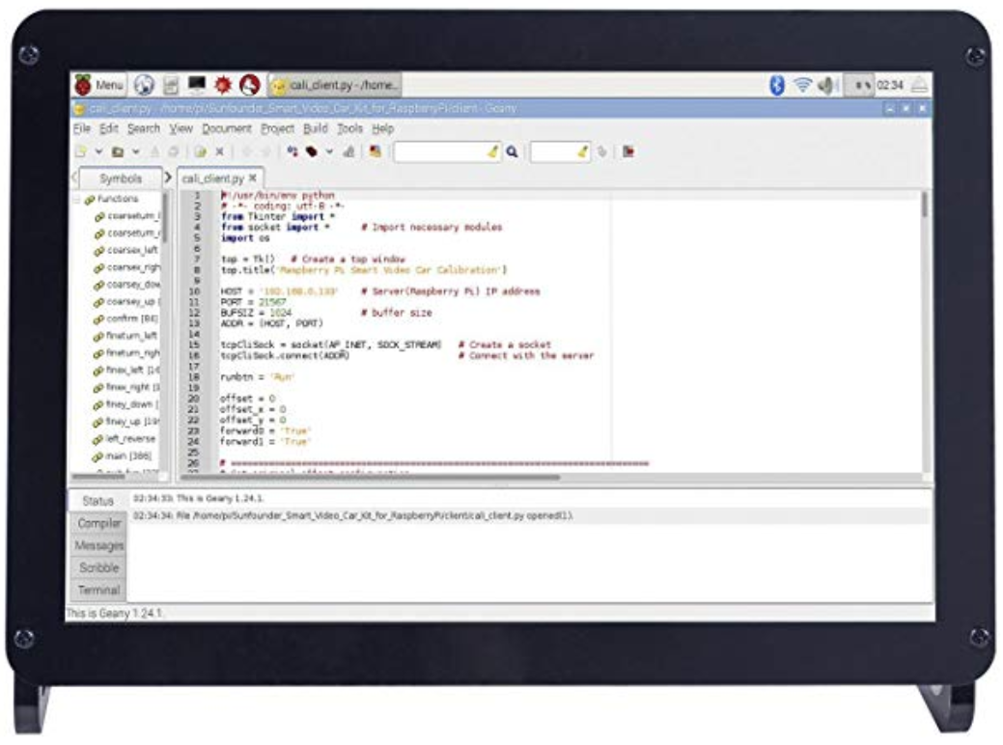
Telnet
Tufts Wireless
Serve Webpage to control EVs
Read EV3 IP Addresses
EV3s Running EV3Dev with CanaKit WiFi Dongles
Intel Stick &
10.1" IPS Display Panel
Student Computers
Hardware
Wireless Network
Programming Task

Slide 10
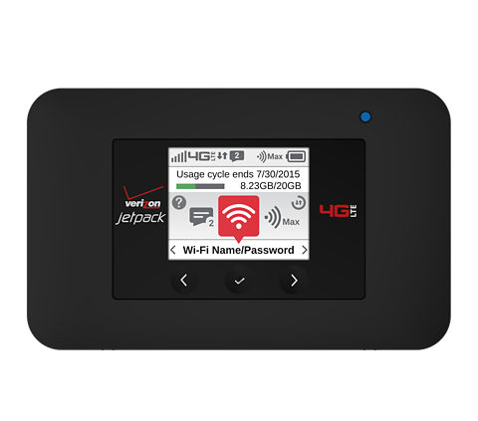
Telnet
Local Area Network
Internet
Serve Webpage to control EVs
Read EV3 IP Addresses
Broadcast LAN
Verizon 4G Jetpack
EV3s Running EV3Dev with CanaKit WiFi Dongles
Intel Stick &
10.1" IPS Display Panel
Student Computers
Hardware
Wireless Network
Programming Task

Slide 11
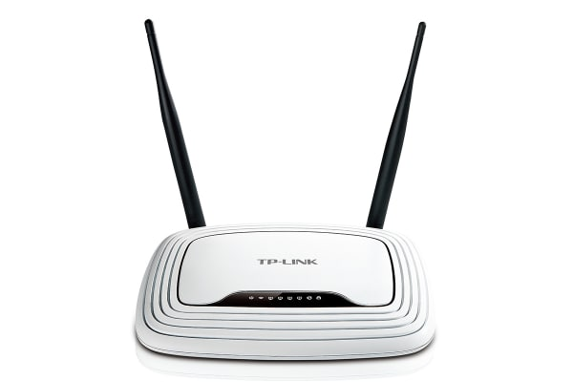
Telnet
Local Area Network
Internet
Serve Webpage to control EVs
Read EV3 IP Addresses
Broadcast LAN
Verizon 4G Jetpack
*
EV3s Running EV3Dev with CanaKit WiFi Dongles
Intel Stick &
10.1" IPS Display Panel
Student Computers
Hardware
Wireless Network
Programming Task
*Router may be needed for LAN

Slide 12

Telnet
Local Area Network
Internet
Serve Webpage to control EVs
Read EV3 IP Addresses
Broadcast LAN
Verizon 4G Jetpack
*
EV3s Running EV3Dev with CanaKit WiFi Dongles
Intel Stick &
10.1" IPS Display Panel
Student Computers
Hardware
Wireless Network
Programming Task
*Router may be needed for LAN

